Slide 1


INDUSTRIAL PROJECT BASED LEARNING DATA SCIENCE

Slide 2



Capstone-Project-2: Data Visualization and Inference Modeling The Case of Nifty
CORRELATION
HEATMAP
HISTOGRAM
ON Monthlyand Yearly
RETURNS
PREPARING MODELS
Final implementation
This Photo by Unknown Author is licensed under CC BY-NC-ND

Slide 3
Uses of Virtual Reality

Slide 4
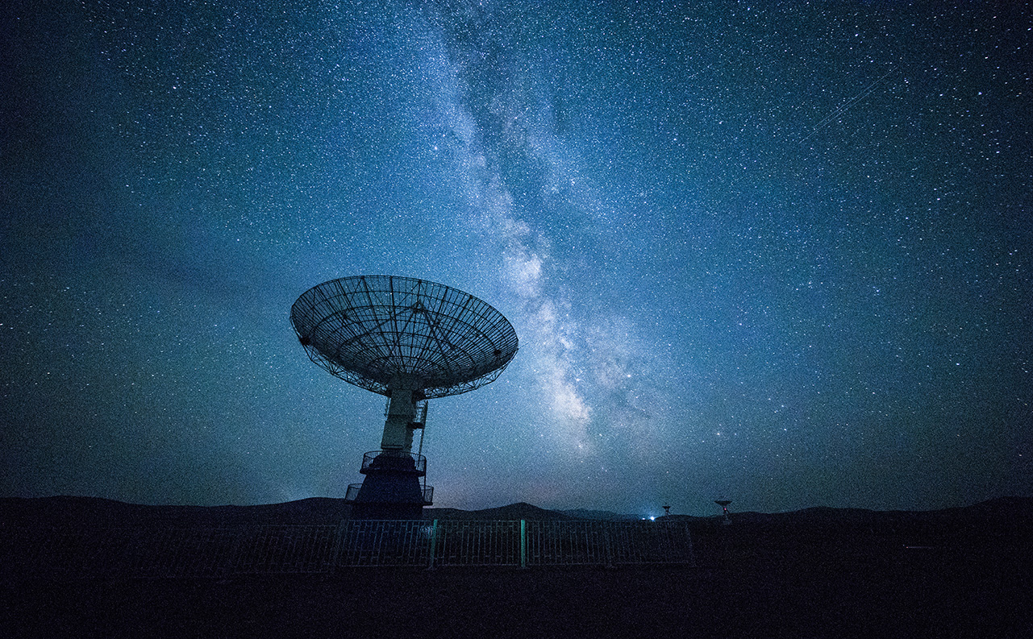
DIFFERENT MODELING
linear regression
Decision Tree Regression
Gradient Boosting Regression
Random Forest Classifier

Slide 5

Thank You!
someone@example.com

